Slide 1
Project Management in GitHub
Anshul T. Tambay
Technical Program Manager, Scientific Software Engineering Center (SSEC) @ eScience Institute
Notes:
Hi! Good morning

Slide 2
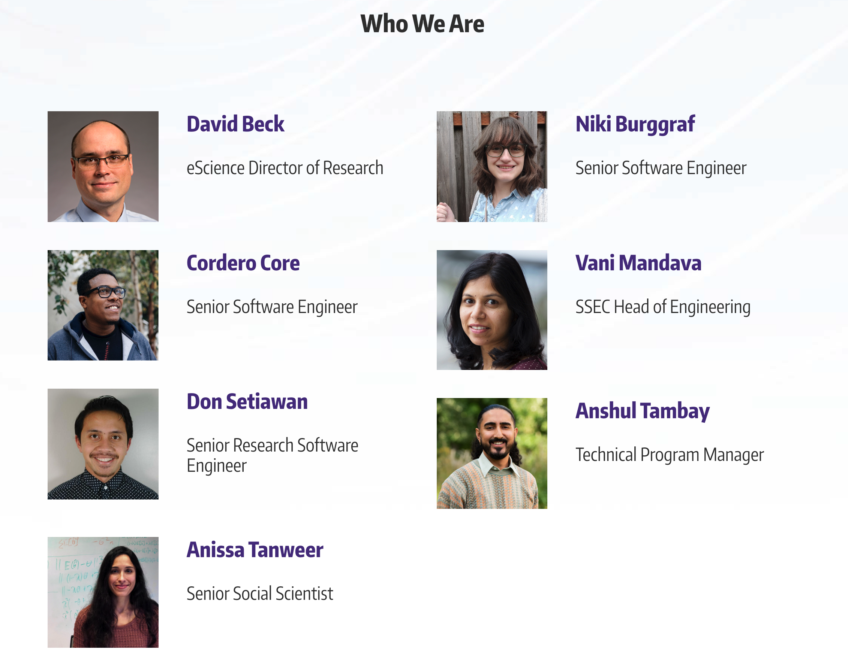


What is SSEC?
Find out more!
Notes:
We are a

Slide 3
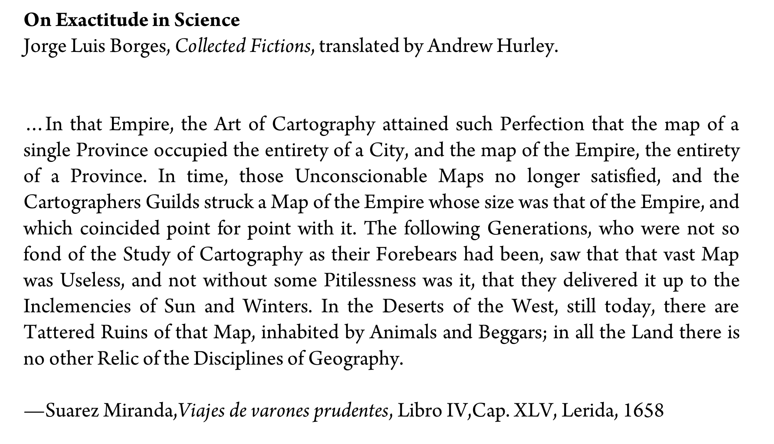
Food for Thought
Carroll → Borges → Gaiman

Slide 4
Goals
Portion tasks
Plan work
Establish estimated timelines
Track progress
Organize
Notes:
What are our goals with Project Management? Keep in mind this tutorial is far more functional than theoretical. More "how', using GH. Than "larger themes"

Slide 5
Principles
Simplicity
Consensus + Communication
Giving it ~ a work cycle
Iteration
Notes:
Of the following tools I will show, please note that you should only take on what is useful. There's a reason they're called bells and whistles and not gears and pistons.

Slide 6
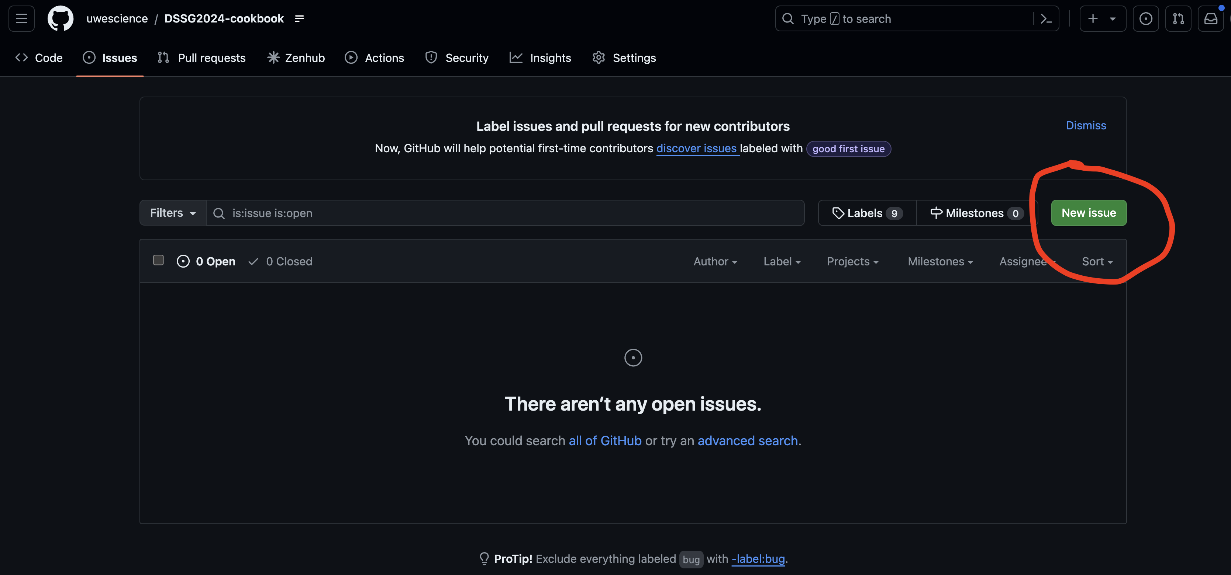
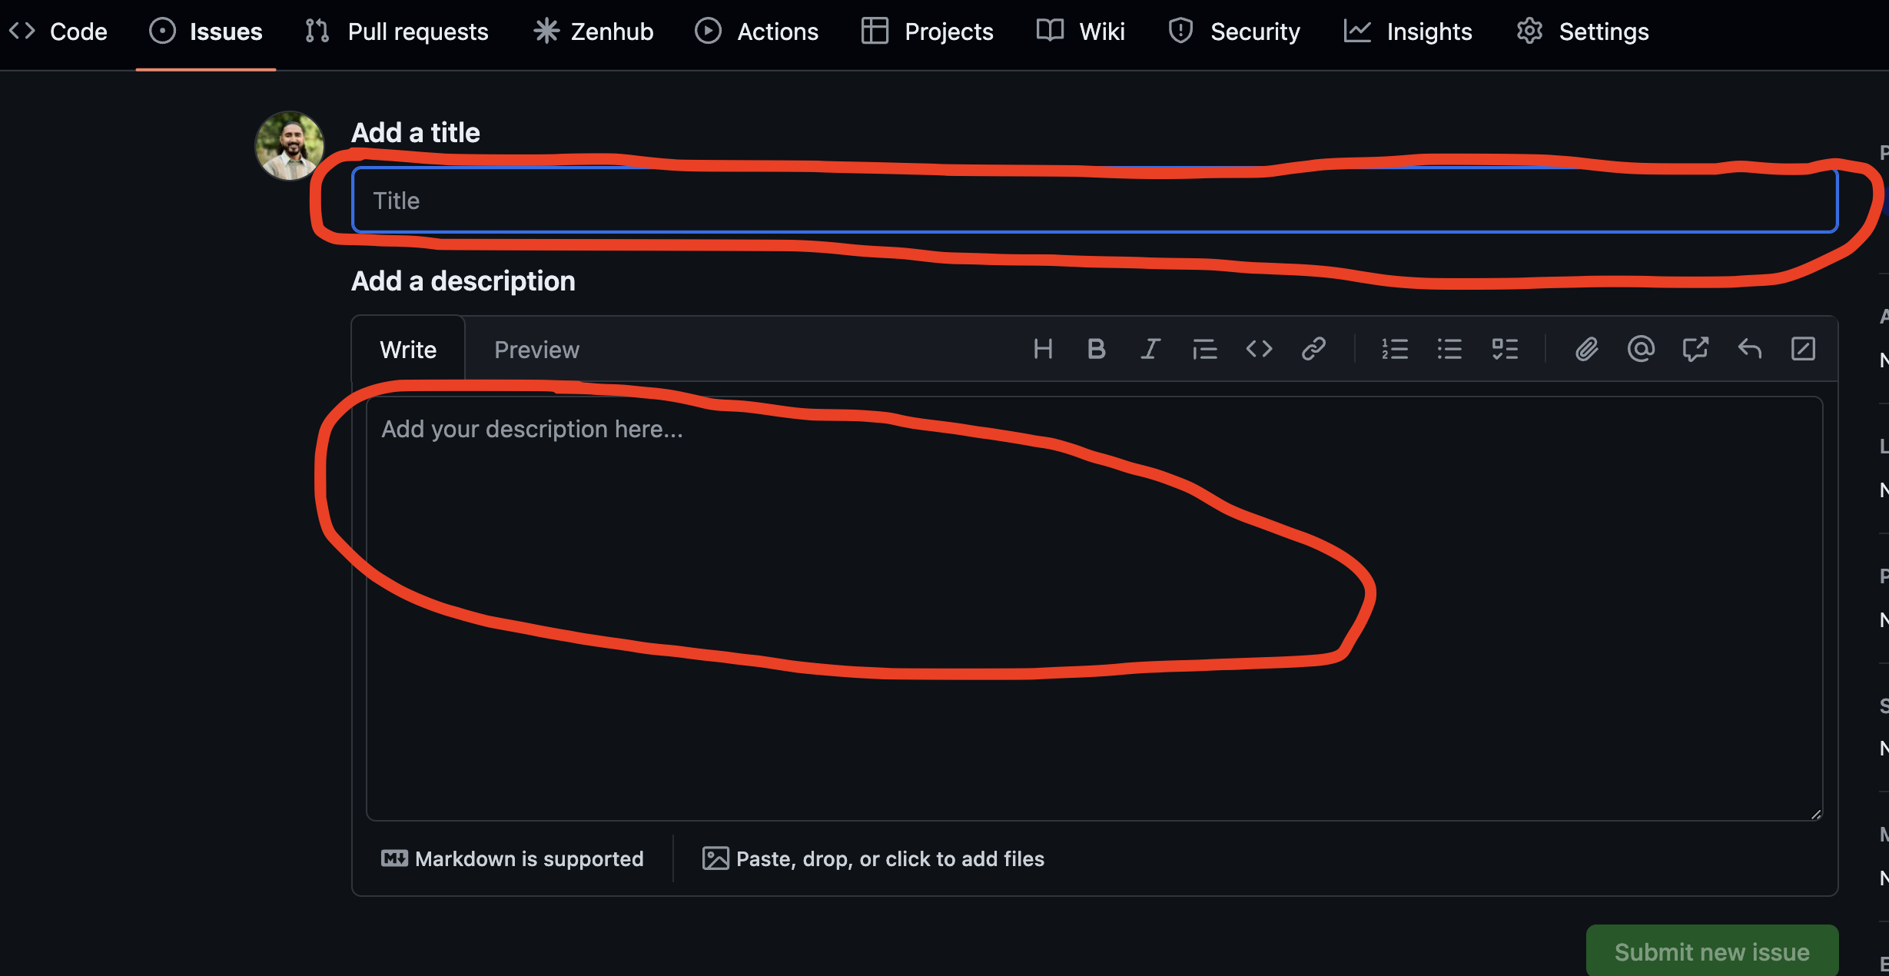
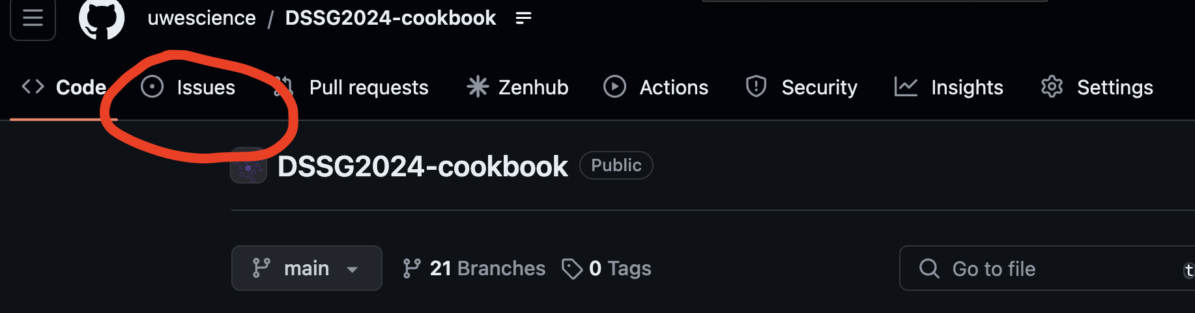
Issues
Smallest units of work
Any project related tasks
“What specifically am I working on rn?”

Slide 7
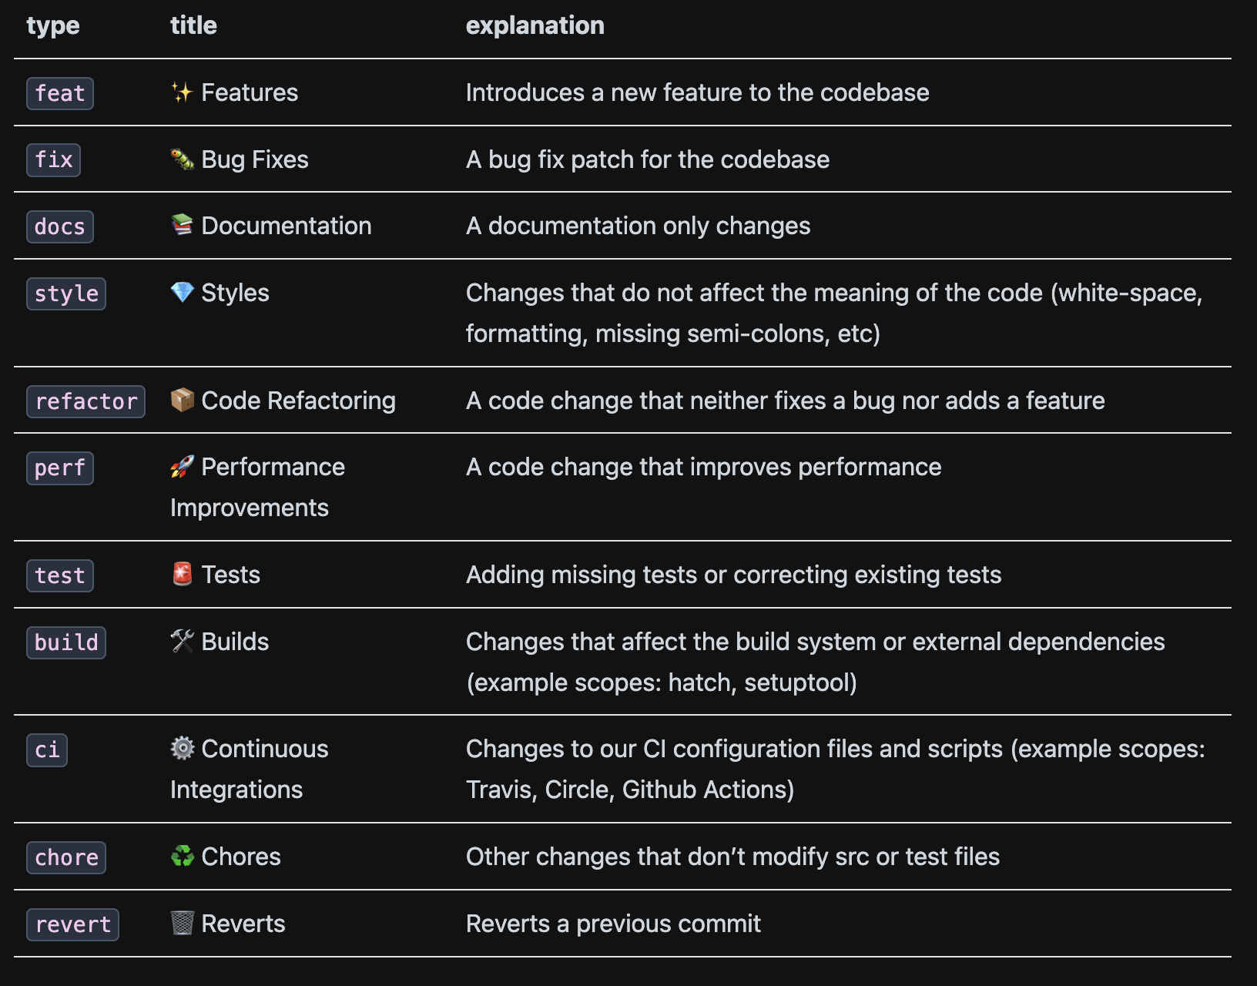
Nomenclature
Give a general idea of what category the issue falls in
”What type of task is this?”
feat:add shared playlists

Slide 8
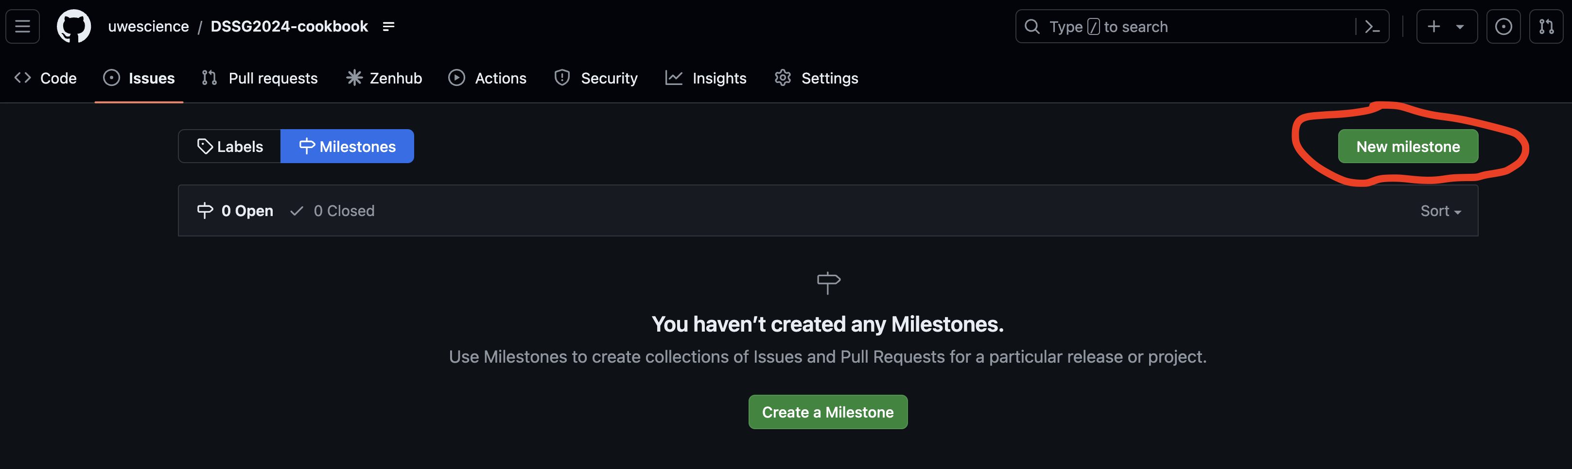
Milestones
Discrete groups of issues
Track Progress
”What are the larger pieces, and by when should each be done?”

Slide 9
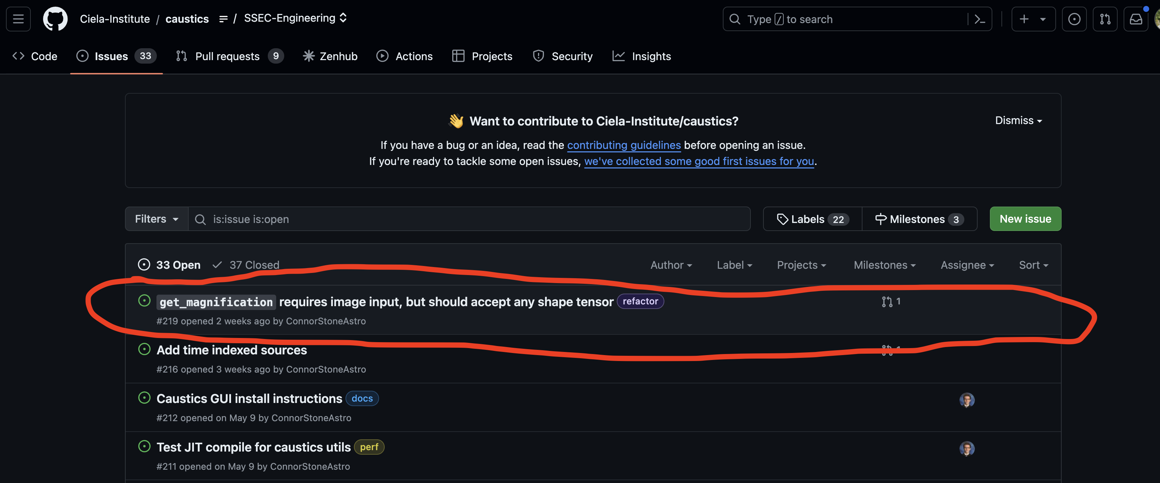
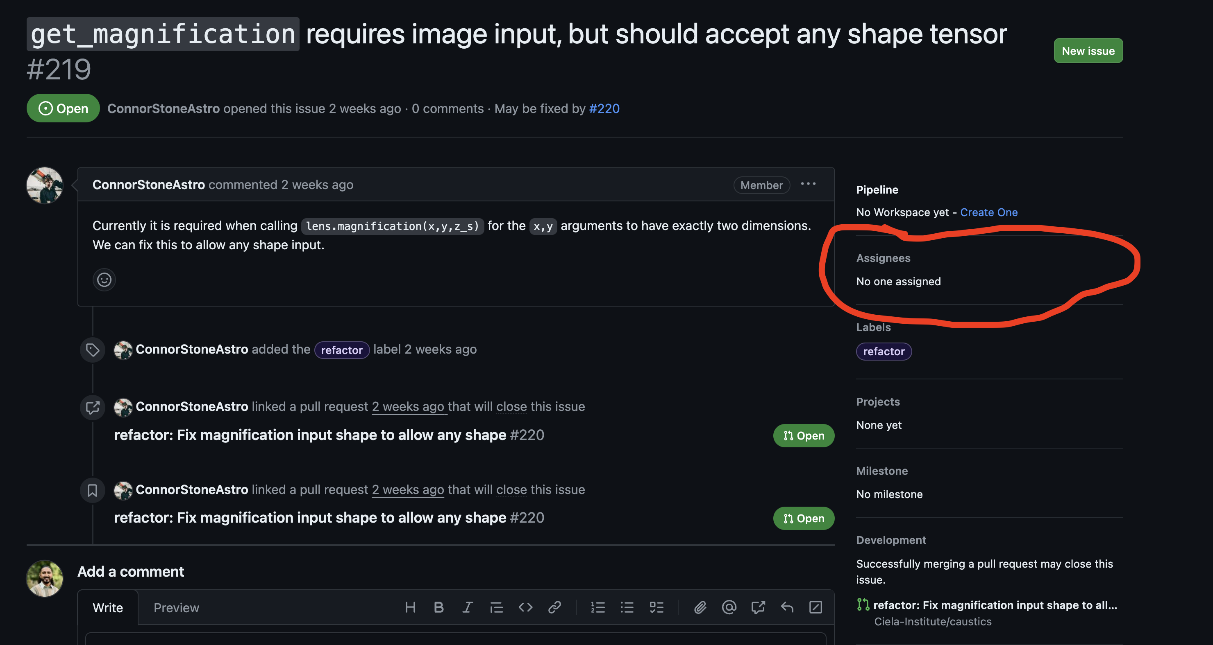
Assigning
Distributing work amongst the team: for completion and review
“Who’s responsible for this?”

Slide 10
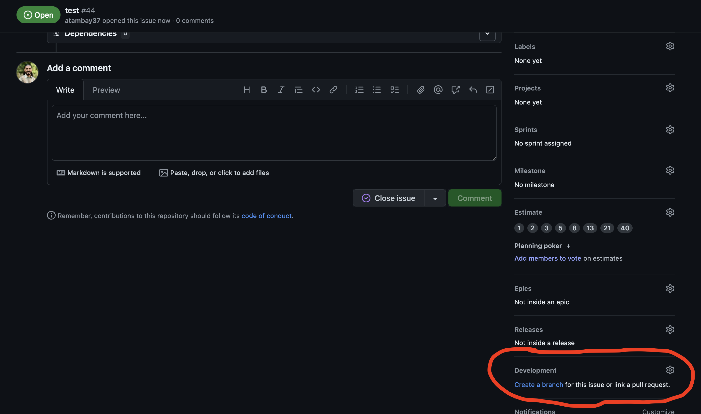
Branches
In most large collaborative settings, branches live and die with issues. Branch:Issue, 1:1.
“Where is this work being done?”

Slide 11
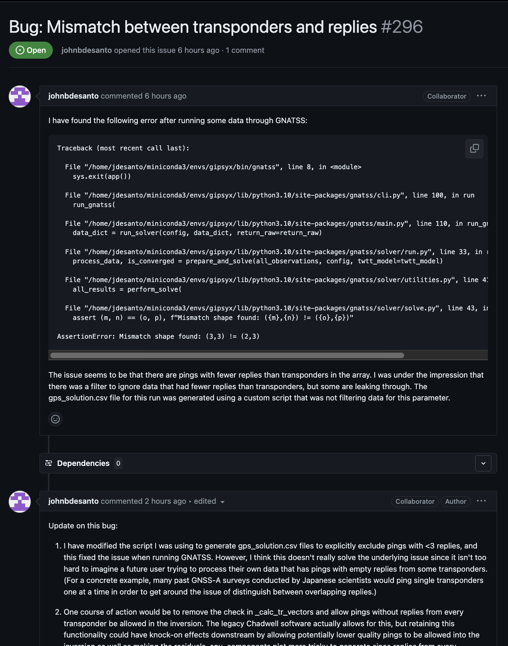
Discussion Threads
Communicate!
“Hey, what’s going on?”
Mention:
Other issues
PRs
Commits

Slide 12
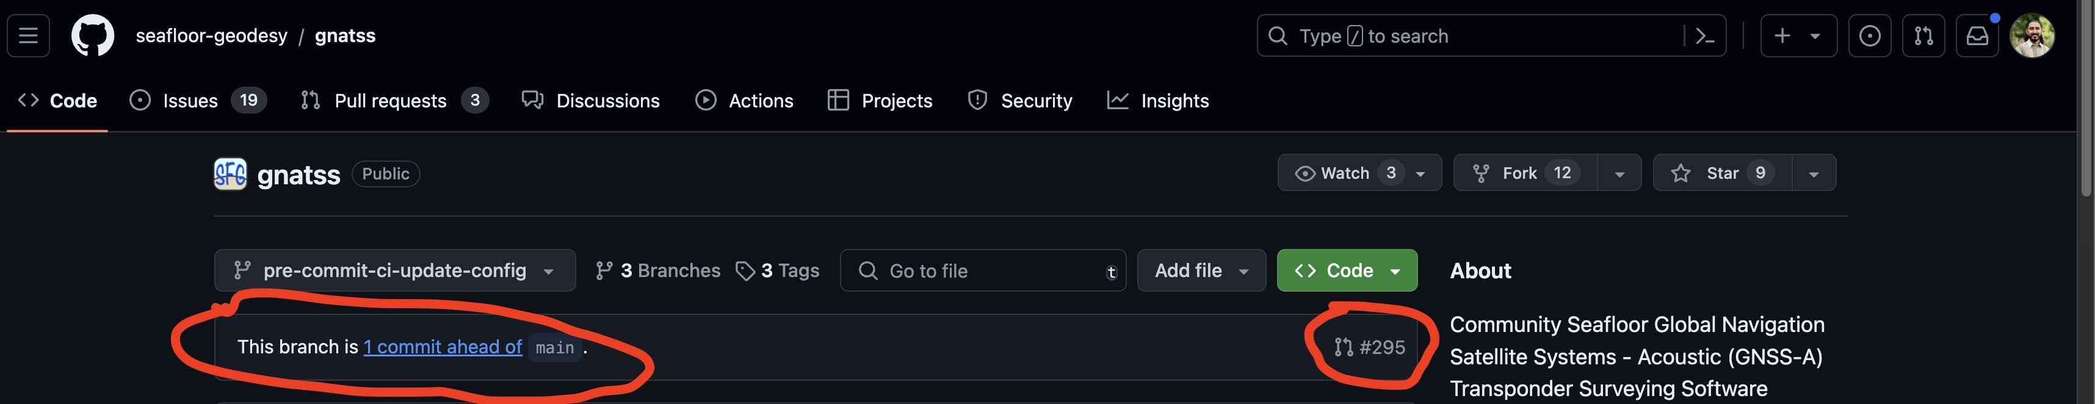
Pull Requests
Issue is ready for review and inclusion in main branch
Link to Issues by mentioning the issue in the PR
“I’d like to close this issue with my work.”
“Could you please take a look?”

Slide 13
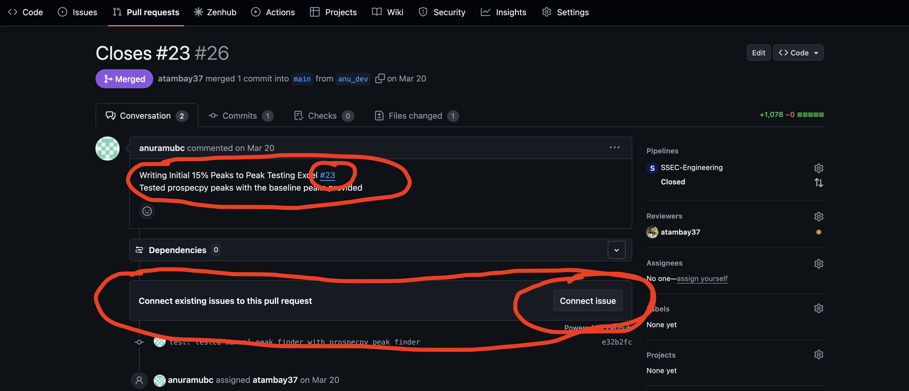
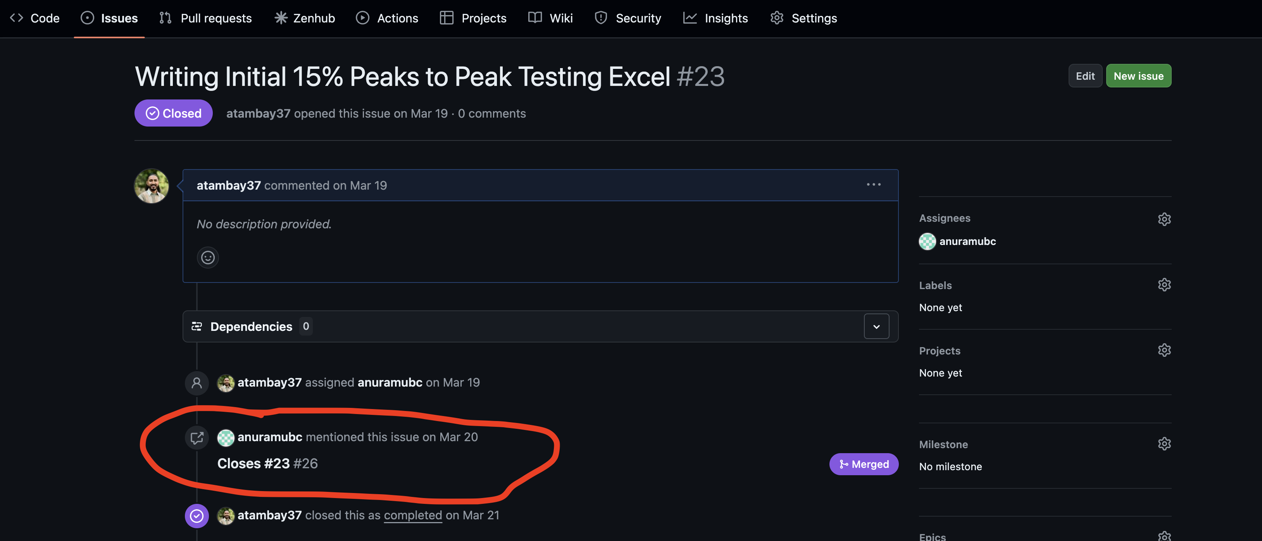
Mentioning
The tie that binds each of the structures we just discussed
Linking:
Issues
PRs
Branches

Slide 14
Your Turn
This Photo by Unknown Author is licensed under CC BY-NC-ND

Slide 15
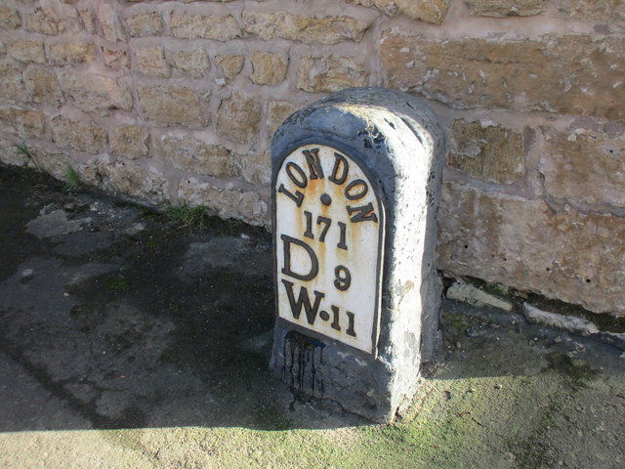
Creating Milestone
This Photo by Unknown Author is licensed under CC BY-SA

Slide 16
Split Into Teams!

Slide 17
Steps
Write Issue
Assign
Create Branch
Complete Work
Talk about it! (Discussion)
Open a Pull Request, assign to Naomi or myself for review

Slide 18
Discussion (offline)

Slide 19
The Beyond
Task Lists
GitHub Projects
ZenHub (gasp)

Slide 20
Principles, Reprise
Simplicity
Consensus + Communication
Give it ~ a work cycle
Iteration

Slide 21
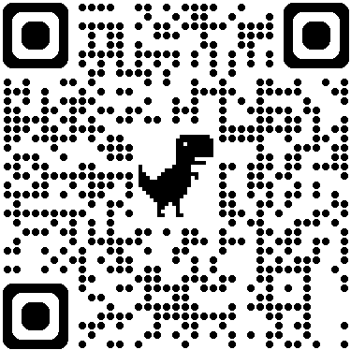
Resources
Andscape Reference on GitHub for PM
GitHub Docs
Example workflows

Slide 22
Questions?
Please feel free to ping me on Slack
Office Hrs (ish): I’ll be around till this afternoon at 12:30

Slide 23
Sources
Gaiman Story
Carroll and Borges
Andscape Reference on GitHub for PM
GitHub Docs
RSE Guidelines

